Slide 1

TRANSACTIONAL WEB APPLICATIONS
SHOPPERS MART

Slide 2
SUBMITTED TO: STEVE TSHAM MPINDA ATAKY
SUBMITTED BY:
RAVDEEP KAUR ( 2024192 )
ROHIT SAINI ( 2122294 )
NANCY BANSAL (2021590 )

Slide 3
INTRODUCTION
This project is based on a web application where the user can buy things online. This application is the online shopping app “SHOPPERS MART” for the customers to order the items just by login into the account which makes them easily to shop, add to cart and make payments online. So, we decided to make an application to make life simpler by creating a web-based application using PHP and MySQL

Slide 4
TABLE OF CONTENT
SERIAL NO. | CONTENT | PAGE NO.
1. | INTRODUCTION | 3
2. | OVERVIEW | 5
3. | USER STORIES | 6-7
4. | SCREENSHOTS | 8-17
5. | CONTACT US | 17
6. | LOGOUT PAGE | 18
7. | REFERENCES | 19

Slide 5
OVERVIEW
For using the application, User needs to login into the account.
For Login into account, User must register them by entering Emailid and Password.
Once the account is created, User is directed to the Home page.
In the home page, they can see the available products for shopping into the app.
User can search for the available products which he wants to shop from the SEARCH BUTTON. From the menu, user can directly visit the page which is searched.
From the various options, items can be selected and added to the cart.
There is also an option for Editing the item selected and then SAVE Button needs to be pressed. So the items are added to the database.
When the user finalize the items, he can make the payment and the Receipt is generated on the screen.

Slide 6
USER STORIES
As a/an | I want to | So That | Test Criteria
admin | register | Can login with the registered credentials. | Should not be already registered.
admin | login | Can login with the details | Should be registered.
admin | Insert products | Can insert products with its description, price, and images. | There should be some product
admin | View products | Can view details of the products and number of products sold. | Products should be inserted already.
admin | Edit and update the products | Can edit the details of the products. | Products should be inserted already.
admin | Delete the products | Can delete the products that are not available. | Products should be inserted already.
admin | View orders | Can view all the orders done by customers. | Should view the orders listed
admin | View users | Can view the list of all the users of the website. | Should view the list of users
admin | logout | Can logout from the admin session. | Should be logged in.

Slide 7
As a/an | I want to | So that | Test Criteria
customer | register | Can login and use the application to buy products. | Should not be already registered.
customer | login | Can use the application and buy products. | Should be registered.
customer | Search the item required | Can see if the product he/she is looking for, are available on the website | N/A
customer | See the categories of products available | Can look for specific product. | Category should be available.
customer | See the brands of the products available | Can look for specific brand. | Brand should be available.
customer | See the description and price | Be able to look for product specifications and price. | Product should be available.
customer | Add the product/gadget to the cart | Can buy the product by adding to the cart. | Product should be available.

Slide 8
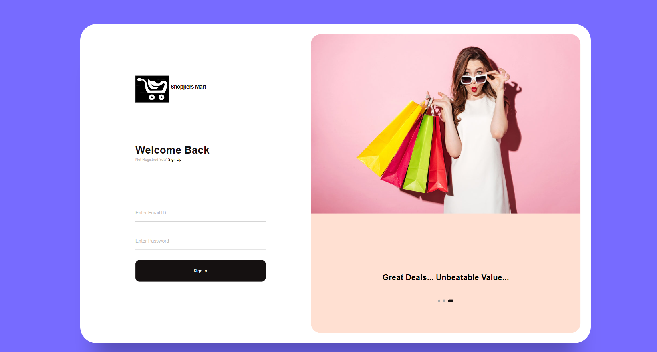
SCREENSHOTS This is the Login Page where customer can login their details .

Slide 9
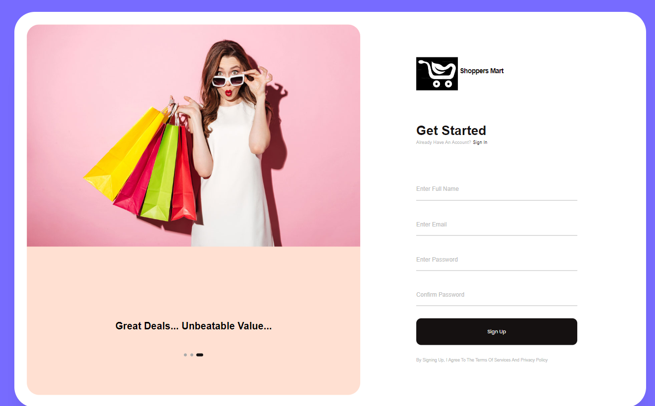
This is the Registration Page where customer can register their details where user can enter Full name, Email, Password ,then account is created .

Slide 10
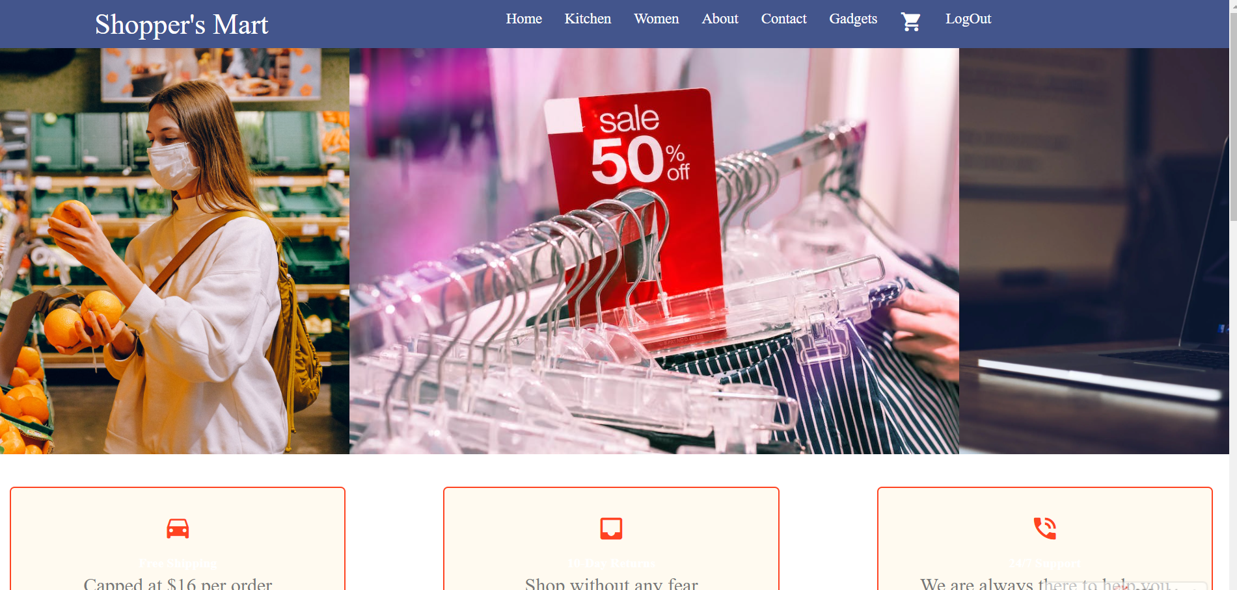
This is the Home page which appears when user login to the application.

Slide 11
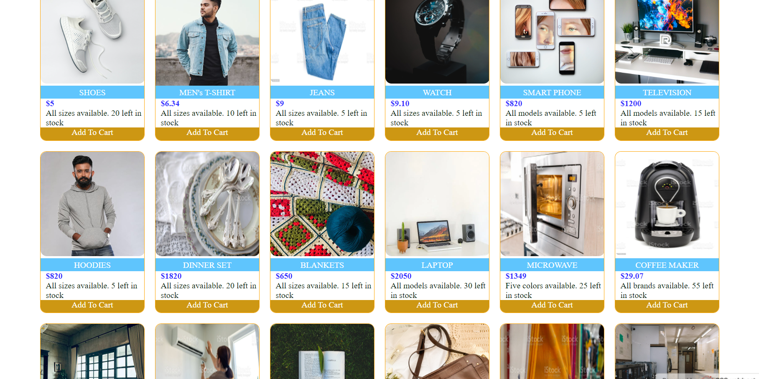
Home page description for variety of products where user can select the category.

Slide 12
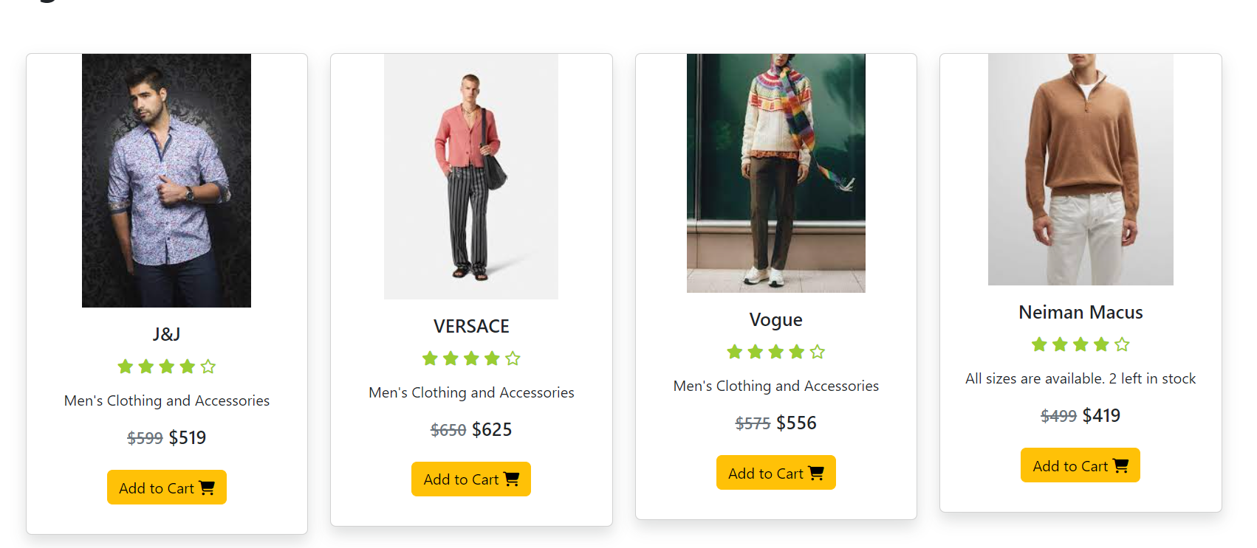
This section displays the clothing for men where customer can select any type of cloth and the item to buy can be adde to the cart.

Slide 13
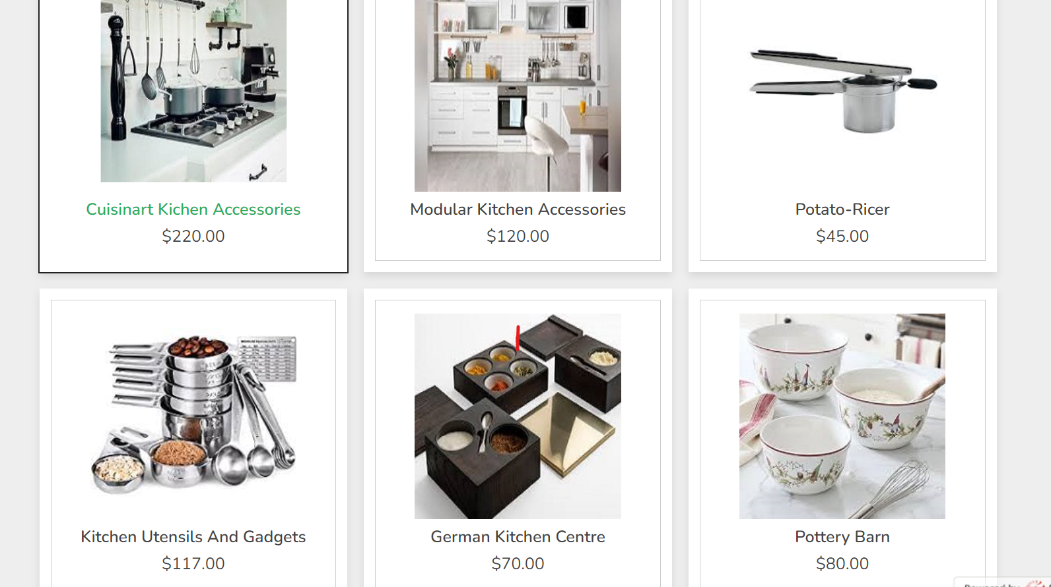
This is the page where customer can select the kitchen appliances

Slide 14
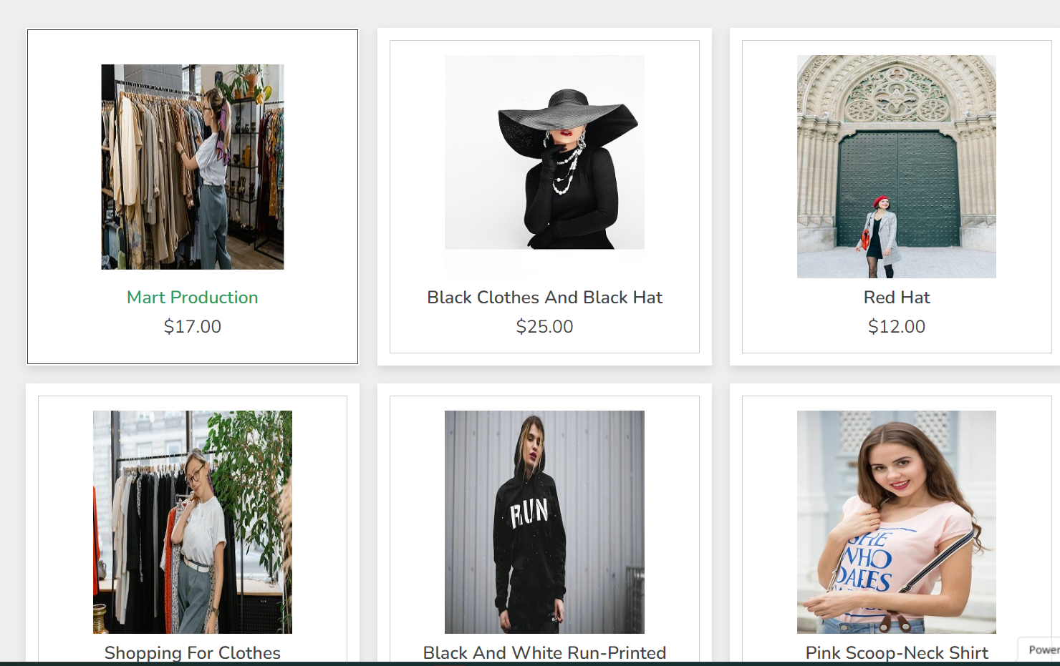
This is the category for Women Dresses where women can select any particular dress which is directed to give the details of unique and ethnic designs.

Slide 15
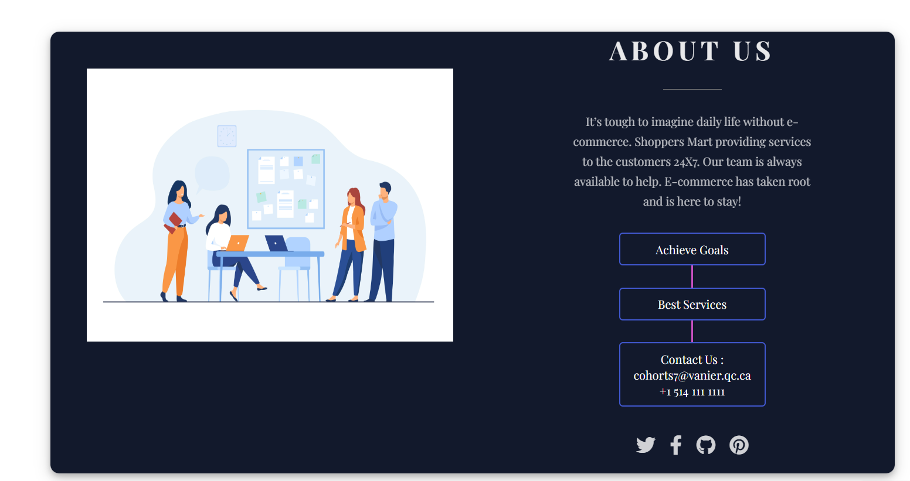
This is the information page for the application where customer can get details regarding the application.

Slide 16
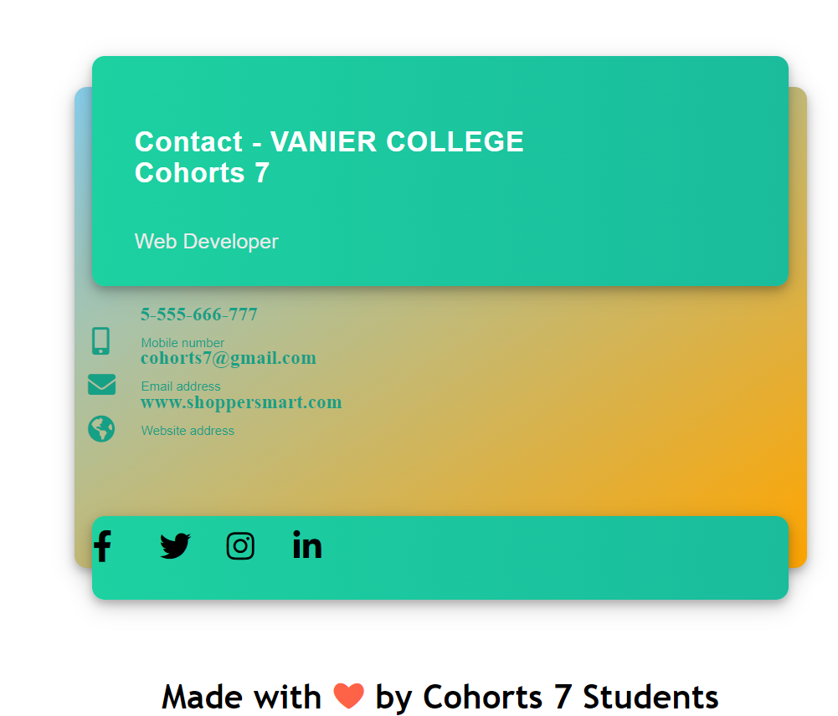
This is the Contact Us page where user can get details on social media.

Slide 17
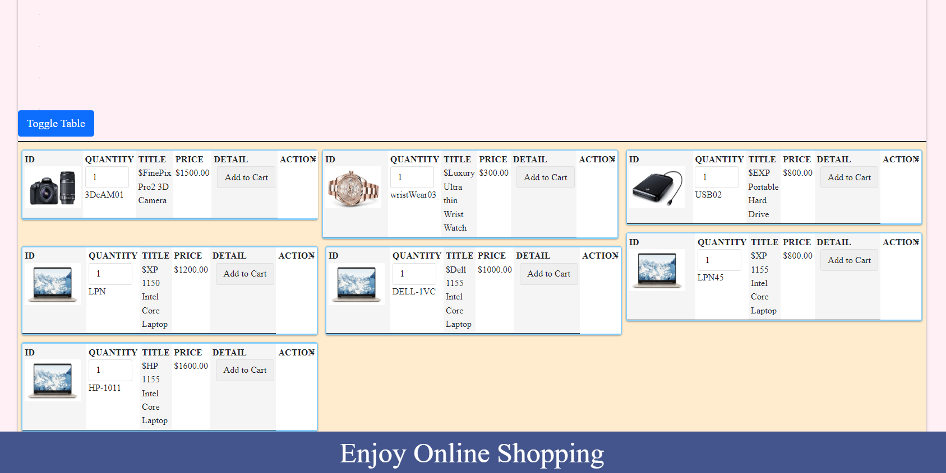
This is the Add to cart where the selected items are added to the cart with details regarding quantity, title, price and detail.

Slide 18
When the customer logged out, he needs to sign-in again with their credentials. If the user is new he needs to register first and then start their shopping.

Slide 19
REFERENCES
ALEX STENHUISER VILVERT
MOHAMMAD HASHIMIDAD

